Slide 1
Functions
Function is a sub program which consists of set of instructions used to perform a specific task. A large program is divided into basic building blocks called function.
Need For Function:
When the program is too complex and large they are divided into parts. Each part is separately coded and combined into single program. Each subprogram is called as function.
Debugging, Testing and maintenance becomes easy when the program is divided into subprograms.
Functions are used to avoid rewriting same code again and again in a program.
Function provides code re-usability
The length of the program is reduced.

Slide 2
Functions
  user defined function
  Built in function
Built in functions
Built in functions are the functions that are already created and stored in python.
These built in functions are always available for usage and accessed by a programmer. It cannot be modified.

Slide 3
Functions
 | Built in function |  | Description
>>>max(3,4) | # returns largest element
4
>>>min(3,4) | # returns smallest element
3
>>>len("hello") | #returns length of an object
5
>>>range(2,8,1) | #returns range of given values
[2, 3, 4, 5, 6, 7]
>>>round(7.8) | #returns rounded integer of the given number
8.0
>>>chr(5) | #returns a character (a string) from an integer
\x05'
>>>float(5) | #returns float number from string or integer
5.0
>>>int(5.0) | # returns integer from string or float
5
>>>pow(3,5) | #returns power of given number
243
>>>type( 5.6) | #returns data type of object to which it belongs
<type 'float'>
>>>t=tuple([4,6.0,7]) | # to create tuple of items from list
(4, 6.0, 7)
>>>print("good morning") | # displays the given object
Good morning
>>>input("enter name: ") | # reads and returns the given string
enter name : George

Slide 4
User Defined Functions
User defined functions are the functions that programmers create for their requirement and use.
These functions can then be combined to form module which can be used in other programs by importing them.
Advantages of user defined functions:
  Programmers working on large project can divide the workload by making different functions.
  If repeated code occurs in a program, function can be used to include those codes and execute when needed by calling that function.

Slide 5
Function definition: (Sub program)
def keyword is used to define a function.
Give the function name after def keyword followed by parentheses in which arguments are given.
End with colon (:)
Inside the function add the program statements to be executed
End with or without return statement

Slide 6
Function definition: (Sub program)
Syntax:
def fun_name(Parameter1,Parameter2…Parameter n):
statement1
statement2…
statement n
return[expression]
Example:
def my_add(a,b):
c=a+b
return c

Slide 7
Function Calling: (Main Function)
Once we have defined a function, we can call it from another function, program or even the Python prompt.
To call a function we simply type the function name with appropriate arguments.
Example:
x=5
y=4
my_add(x,y)

Slide 8
Flow of Execution:
The order in which statements are executed is called the flow of execution
Execution always begins at the first statement of the program.
Statements are executed one at a time, in order, from top to bottom.
Function definitions do not alter the flow of execution of the program, but remember that statements inside the function are not executed until the function is called.
Function calls are like a bypass in the flow of execution. Instead of going to the next statement, the flow jumps to the first line of the called function, executes all the statements there, and then comes back to pick up where it left off.
Note: When you read a program, don’t read from top to bottom. Instead, follow the flow of execution. This means that you will read the def statements as you are scanning from top to bottom, but you should skip the statements of the function definition until you reach a point where that function is called.

Slide 9
Function Prototypes:
i) Function without arguments and without return type
In this type no argument is passed through the function call and no output is return to main function
The sub function will read the input values perform the operation and print the result in the same block
ii) Function with arguments and without return type
Arguments are passed through the function call but output is not return to the main function
iii) Function without arguments and with return type
In this type no argument is passed through the function call but output is return to the main function.
iv) Function with arguments and with return type
In this type arguments are passed through the function call and output is return to the main function

Slide 12
Parameters and Arguments:
Parameters:
Parameters are the value(s) provided in the parenthesis when we write function header.
These are the values required by function to work.
If there is more than one value required, all of them will be listed in parameter list separated by comma.
Example: def my_add(a,b):
Arguments:
Arguments are the value(s) provided in function call/invoke statement.
List of arguments should be supplied in same way as parameters are listed.
Bounding of parameters to arguments is done 1:1, and so there should be same number and type of arguments as mentioned in parameter list.
Example: my_add(x,y)

Slide 13
RETURN STATEMENT
The return statement is used to exit a function and go back to the place from where it was called.
If the return statement has no arguments, then it will not return any values. But exits from function.
Syntax:
return[expression]
Example:
def my_add(a,b):
c=a+b
return c
x=5
y=4
print(my_add(x,y))
Output: 9

Slide 14
ARGUMENTS TYPES
1.Required Arguments
2.Keyword Arguments
3.Default Arguments
4.Variable length Argument
Required Arguments: The number of arguments in the function call should match exactly with the function definition.
Output:
Name:george
Age 56

Slide 15
Keyword Arguments:
Python interpreter is able to use the keywords provided to match the values with parameters even though if they are arranged in out of order.
def my_details( name, age ):
print("Name: ", name)
print("Age ", age)
return
my_details(age=56,name="george")
Output:
Name: george
Age 56

Slide 16
Default Arguments:
Assumes a default value if a value is not provided in the function call for that argument.
def my_details( name, age=40 ):
print("Name: ", name)
print("Age ", age)
return
my_details(name="george")
Output:
Name: george
Age 40

Slide 17
Variable length Arguments
If we want to specify more arguments than specified while defining the function, variable length arguments are used. It is denoted by * symbol before parameter.
def my_details(*name ):
print(*name)
my_details("rajan","rahul","micheal",ärjun")
Output:
rajan rahul micheal ärjun

Slide 18
MODULES
A module is a file containing Python definitions ,functions, statements and instructions.
Standard library of Python is extended as modules.
To use these modules in a program, programmer needs to import the module.
Once we import a module, we can reference or use to any of its functions or variables in our code.
There is large number of standard modules also available in python.
Standard modules can be imported the same way as we import our user-defined modules.
Every module contains many function.
To access one of the function , you have to specify the name of the module and the name of the function separated by dot . This format is called dot notation.

Slide 19
Syntax
import module_name
module_name.function_name(variable)

Slide 20
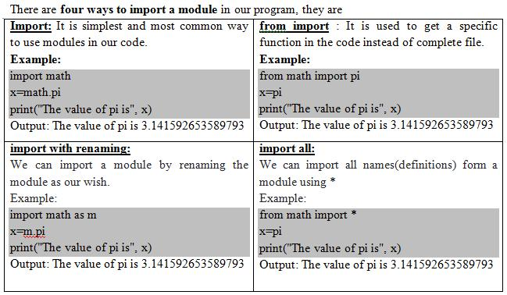
Four Ways to Import Module

